Slide 1
Content-Based Medical Image Retrieval
PUJARA RAHI
19BCE1777

Slide 2
Abstract
Medical imaging is essential nowadays throughout medical education, research, and care.
Accordingly, international efforts have been made to set large-scale image repositories for these purposes.
Yet, to date, browsing of large-scale medical image repositories has been troublesome, timeconsuming, and generally limited by text search engines.
A paradigm shift, by means of a queryby-example search engine, would alleviate these constraints and beneficially impact several practical demands throughout the medical field.
The current project aims to address this gap in medical imaging consumption by developing a content-based image retrieval (CBIR) system, which combines two image processing architectures based on deep learning.

Slide 3
Furthermore, a first-of-its-kind intelligent visual browser was designed that interactively displays a set of imaging examinations with similar visual content on a similarity map, making it possible to search for and efficiently navigate through a large-scale medical imaging repository, even if it has been set with incomplete and curated metadata.
Users may, likewise, provide text keywords, in which case the system performs a content- and metadata-based search.
The system was fashioned with an anonymizer service and designed to be fully interoperable according to international standards, to stimulate its integration within electronic healthcare systems and its adoption for medical education, research and care.
Professionals of the healthcare sector, by means of a self-administered questionnaire, underscored that this CBIR system and intelligent interactive visual browser would be highly useful for these purposes.
Further studies are warranted to complete a comprehensive assessment of the performance of the system through case description and protocolized evaluations by medical imaging specialists.

Slide 4
Keywords :
clinical
content-based image retrieval
education
imaging
interactive visual browser
query-by-example
research

Slide 5
Introduction :
Nowadays, imaging plays a central role in medicine.
Large amounts of imaging data are constantly generated in daily clinical practice, leading to continuously expanding archives, and ever progressive efforts are being made across the world to build large-scale medical imaging repositories .
This trend is in line with the increasing medical image consumption needs, which have been studied and categorized into four groups: patient care-related, research-related, education-related, and other .
In the era of big data, however, navigating through large-scale medical imaging archives is becoming, correspondingly, increasingly troublesome.

Slide 6
Browsing any available, large-scale medical imaging repository through a conventional text-based search engine is time-consuming, severely hampered if the repository lacks curated or expert-annotated metadata, the search results display options are limited.
Conversely, the need for collecting curated or expert-annotated metadata may, in turn, be preventing the building of large, multi-center, international medical imaging repositories that meet the medical imaging needs of today.
In this scenario, there is an enormous need for efficiently archiving, organizing, managing, and mining massive medical image datasets on the basis of their visual content (e.g., shape, morphology, structure), and it may be expected that this demand will only become more substantial in the foreseeable future.
Looking towards their implementation in the daily clinical workflow, however, there remain technical challenges.
Large-scale repositories, reciprocally, are needed for CBIR systems to deliver appealing search results.

Slide 7
For that purpose, in turn, local teams with experience in the use of healthcare integration standards are required.
For multi-center collaborative efforts, there is also needed a data extractor inside each institution to anonymize, and transfer and convert data to a standardized semantic term.
The aim of the present project was to develop a CBIR system using learned latent image representation indexation, with a visual content, similarity-based, intelligent and interactive visual browser for efficient navigation.
The system was developed using international standards to be fully interoperable to ease integration into routine clinical workflow and, thus, support current medical image demands throughout education, research and clinical care.
Novel deep learning architectures have also empowered internal image representation learning, specifically, latent representations, which can be used to implement ground-breaking image content search engines .

Slide 8
Formally, a CBIR system is a quadruple {D, Q, F, R (qi , dj )}, where:
(i) D is a set composed of representations for the images in a given collection,
(ii) Q is a set of representations for user information needs, operationally known as queries,
(iii) F is a representational framework that allows images, queries, and their relationships to be jointly modeled, and, finally,
(iv) R(qi , dj ) is a ranking function which associates a real number with a query qi in Q and an image dj in D. The ranking defines an ordering among the images in a given collection regarding the query q.

Slide 9
Problem statement :
This keynote presentation aims at giving a historical perspective of how medical image retrieval has evolved from a few prototypes using first only text, then global visual features to the current multimodal systems that can index many types of images in large quantities and use deep learning as a basis for the tools .
It also aims at looking at what the place of image retrieval is in medicine, where it is currently still only sparsely used in clinical practice.
It seems that it is mainly a tool for teaching and research.
Certified medical tools for decision support rather make use of specific approaches for detection and classification.

Slide 10
Motivation:
Medical imaging is one of the largest data producers in the world and over the last 30 years this production increased exponentially via a larger number of images and a higher resolution, plus totally new types of images.
Most images are used only in the context of a single patient and a single time point, besides a few images that are used for publications or in teaching.
Data are usually scattered across many institutions and cannot be combined even for the treatment of a single patient.
Much knowledge is stored in these medical archives of images and other clinical information and content-based medical image retrieval has from the start aimed at making such knowledge accessible using visual information in combination with text or structured data.
With the digitization of radiology that started in the mid 1990s the foundation for broader use was laid out.

Slide 11
Approach:
The presentation follows a systematic review of the domain that includes many examples of systems and approaches that changed over time when better performing tools became available.
Medical mage retrieval has evolved strongly, and many tools linked to mage retrieval are now employed as clinical decision support but mainly for detection and classification.
Retrieval remains useful but is often integrated with tools and thus has become almost invisible.
A second aspect of the presentation includes a presentations of existing data sets and other resources that were difficult to obtain even ten years ago, but that have been shared via repositories such as TCGA , TCIA , or via scientific challenges such ImageCLEF or listed in the Grand Challenges web page .

Slide 12
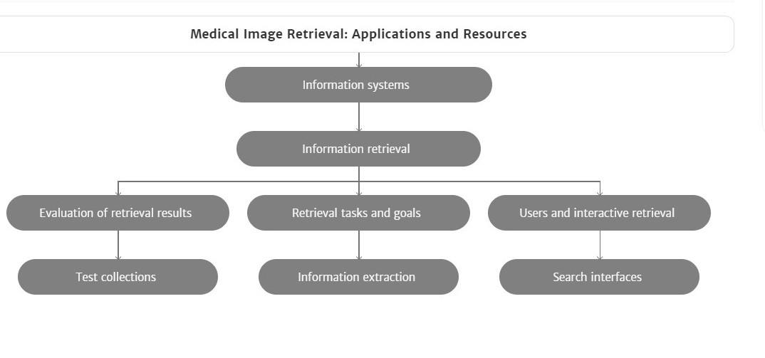

Slide 13
Literature Survey :
Image preprocessing is the first step of image retrieval to ensure accuracy of subsequent steps.
The images acquired through different modalities cause many artifacts such as low resolution, noise and extra cranial tissue etc.
which reduces the accuracy of acquired result.
In order to overcome the above problem preprocessing of an image is required.
An analysis on filtering techniques such as Gabor & QMF filters for noise is performed by .
These primitive methods along with reducing the noise blur the important and detailed structure necessary for subsequent steps.
In order to increase the processing speed and to reduce the error probability of mammogram images Morphological top hat filtering algorithm is utilized in .
But these types of filtering are applicable for mammogram images only. To eliminate the noise in images, Gaussian filter is suggested in .

Slide 14
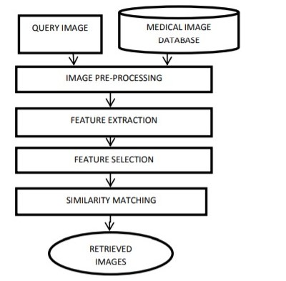

Slide 15
Materials and Methods
Integration with the hospital (Clinical Hospital University of Chile, Santiago, Chile) to have continuous feeding of medical images and metadata was composed of different microservices.
First, a Mirth Connect integration system was used to receive data in different health standard types, DICOM channels, HL7 messages, and HL7-FHIR messages.
Mirth Connect was integrated to an Anonymizer service, which eliminates all patients’ personal data and extracts healthcare data to feed an FHIR server using international standardized health terms (SNOMED-CT, ICD-9, ICD-10).
This allows the development of an interoperable and standardized repository.
The Institutional Review Board approved (METc 2020/035, on 8 July 2020) the storage and management of thorax computed tomography in this repository.
All procedures were conducted in adherence to the declarations of Helsinki.

Slide 16
Deep Learning-Based Medical Image Indexation and Retrieval Strategy
Two image processing architectures based on deep learning were combined.
The first, CE-Net (Context Encoder Network) , was used to build a representation of the input image in a lower dimensional space, i.e., a latent representation.
Using these image embeddings, a second neural architecture was trained, Xception , which is capable of learning a new representation of the input image.
This architecture is trained to solve a diagnosis classification task, which helps group images that coincide with their initial diagnosis.

Slide 17
CE-Net
The image segmentation architecture CE-Net was used first, which allows 2D medical images to be processed.
The CE-Net architecture is an extension of the U-Net architecture , which is an encoder-decoder architecture.
Encoder-decoder architectures work with a tandem of neural layers, wherein the first architecture block, the encoder, is a sequence of layers responsible for building a representation of the input image in a lower dimensional space, known as latent space.
The second architecture block, the decoder, is another sequence of layers responsible for transforming the encoding from latent space to original space, recovering the original dimensionality of the image.

Slide 18
The layers of the U-Net architecture are convolutional, introduce max-pooling operators, and add residual connections to prevent the network from the loss of information between layers.
This allows the construction of lower dimensional representations that retain the most important information from the encodings obtained in the previous layers.
The architecture parameters are adjusted in such a way as to minimize the reconstruction error.
Thus, the encoder-decoder architectures are intended to encode the images in the latent space.
The CE-Net architecture extends the U-Net architecture by incorporating two processing modules: the dense à-trous convolution (DAC) and the residual multi-kernel pooling (RMP) module.
Both modules were designed to capture high-level characteristics, preserving spatial information throughout the encoder-decoder architecture.
These representations were used to feed the second neural architecture used by the system, the Xception.

Slide 19
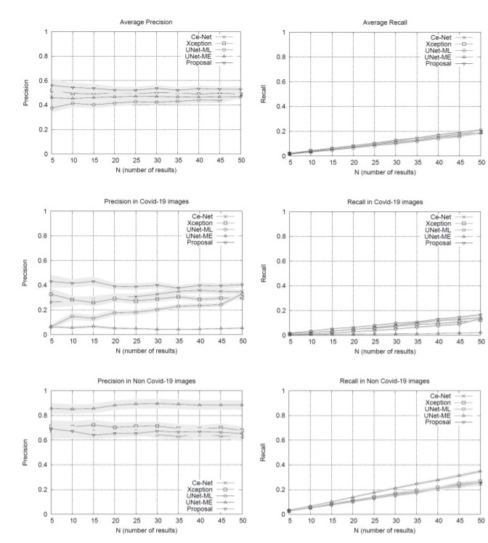
By separating the testing set between COVID-19 and non COVID-19 queries, the results in Figure 1 show that our method obtains advantages over other methods when using queries of patients with COVID-19, surpassing by a significant margin the most direct competitor, the Xception network.
The other methods have lower performances.
U-Net-ME performs well in the healthy patient class.
However, this model exhibits overfitting to this class as its performance in the COVID-19 class is very low.
Our proposal surpasses the other methods in COVID-19 images regarding recall rates, while U-Net-ME generates a better recall in images of healthy patients.
The results confirm that our proposal is suitable for searching for images of COVID-19 patients, surpassing all its competitors in precision and without generating overfitting to any of the classes.
With the Ce-Net + Xception network validated, latent vectors were indexed in a nearest neighbors query engine, which is the basis of the intelligent visual browser.

Slide 20
Back-End
The combination CE-Net + Xception constitutes the back-end of the browser.
The back-end provides a vector representation of all the images in the repository, i.e., the latent representations constructed using the CE-Net + Xception allow obtaining continuous and dense vectors of the same dimensionality for all the images in the repository.
It is noteworthy that combining these architectures makes metadata availability requirements more flexible since none of the networks require metadata for ingested imaging datasets.
This means that images of different types could be received without metadata, and all of them would have a latent representation in the same latent space that Xception uses for classification.
Moreover, images of latent representations retrieved by Xception are expected to be separated by types of images (as a result of the CE-Net segmentation model) and by diagnosis (as a result of the Xception classification model).
The clustering hypothesis according to type of image and diagnosis is supported by the combination of both architectures in tandem.
This means that while the segmenter allows different types of medical images to be represented in the same representation space, the Xception network helps to separate them by diagnosis.
It is worth mentioning that if diagnostic metadata is not available, the Xception network will obtain the representation of the unlabeled images using them as a testing partition.

Slide 21
Front-End
The front-end is responsible for enabling the search engine on the repository.
To do this efficiently, the images are indexed using an efficient data structure that allows searching for close neighbors.
This data structure is Multiple Random Projection Trees (MRPT) , which is considered to be state-of-the-art in the approximate search for close neighbors.
MRPT allows the building of a search index with recall guarantees.
This means that we can indicate a minimum recall rate and the structure is built in a way that satisfies this restriction.
This element is important because if the repository grows in volume, an index that scales to a larger volume of data will be required.
Once the index has been built, queries of close neighbors can be run.

Slide 22
The user determines the number of nearest neighbors from the repository and returns the identifiers of the corresponding images.
Queries are new images that do not need to be labeled, i.e., they do not need to be entered with any accompanying text.
To enter it as a query, the image is first segmented using the CE-Net network pre-trained on the repository images.
After retrieving its latent vector and ingesting it in the Xception network, the latent vector is retrieved from the Xception network, which is used as a representation of the image.
This vector is in the same latent space as the images indexed in MRPT, so it can be used as a query vector to retrieve its nearest neighbors.
As the representation is built on the same pipeline with which the repository images have been processed, the nearest neighbors will correspond to images that are similar in content, both in segmentation structure and diagnosis.

Slide 23
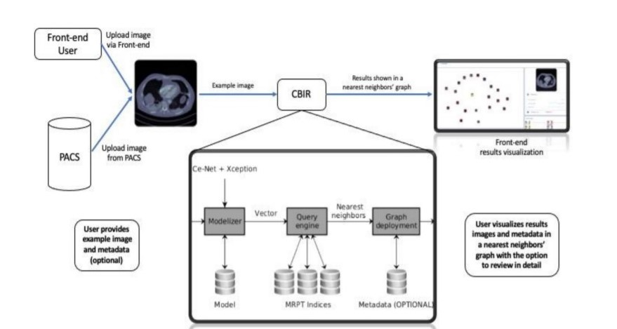
Pipeline of the proposed system.
A query image is provided via the front-end or sent directly from the institution’s PACS.
The system has a query pipeline on the front-end of the intelligent interactive visual browser for medical images.
A new image is processed using the CE-Net + Xception architectures to obtain its vectorized latent representation.
The query engine accesses the repository indexes, retrieving the nearest neighbors images from the repository, which are displayed by the interactive visual browser for medical images .
Metadata, whenever available, is also displayed.
Then, the nearest neighbors’ graph is shown in the front-end to visualize the results.

Slide 24
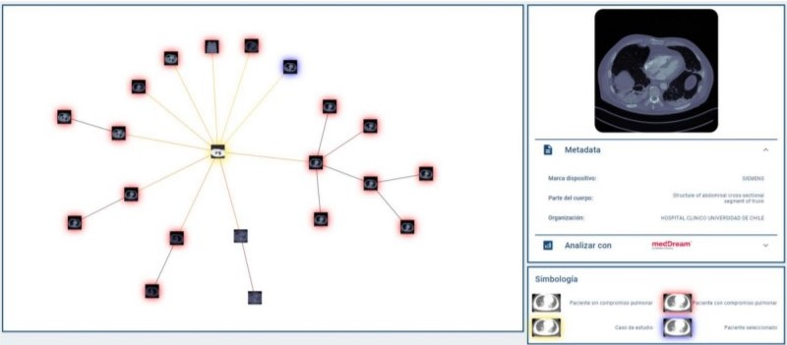
A new image is used to formulate a query.
The user has the option to also include a diagnosis or other keywords.
The query engine displays nearest neighbors’ graph centered around the query image (yellow).
The user can select an image from the graph, which displays the image’s metadata tab, if the metadata is available.
The system is currently available in Spanish (marca dispositivo, device brand; parte del cuerpo, body part; organización, organization; simbología, symbology).
Since the browser is based on proximity searches, creating an ego network around the query image would provide valuable information to the user as to understand the different groups of images that make up the set of results.

Slide 25
Conclusions:
We developed a deep learning-based CBIR system and a first-of-its-kind intelligent visual browser that interactively displays on a similarity map a set of imaging examinations with similar visual content, making it possible to search for and efficiently navigate through a large-scale medical imaging repository, even if it has been set with incomplete and curated metadata.
The system was fashioned with an anonymizer service and designed to be fully interoperable according to international standards in order to stimulate its integration within healthcare systems and its adoption for medical education, research, and care.
Professionals of the healthcare sector, by means of a self-administered questionnaire, underscored that this CBIR system and intelligent interactive visual browser would be highly useful for these purposes.
Further studies are warranted to complete a comprehensive assessment of the performance of the system through case description and protocolized evaluations by medical imaging specialists.

Slide 26
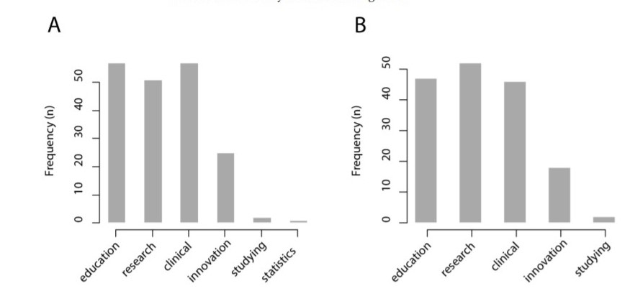
Results of the survey among professionals of the healthcare sector (n = 67). Medical education, research, and clinical care were considered the most relevant use cases for (A) a content-based medical image retrieval system and (B) an intelligent interactive visual browser.

Slide 27
Author Contributions:
Conceptualization, M.M., V.C., M.S., and M.A.; methodology, M.M., V.C., M.S., and M.A.; formal analysis, C.G.S. and V.C.; investigation, C.G.S., M.M., V.C., H.F., G.M., M.S., and M.A.; resources, G.P., S.H., M.A.; data curation, C.G.S., V.C.; writing—original draft preparation, C.G.S.; writing—review and editing, M.M., V.C., H.F., G.M., G.P., S.H., M.S., and M.A.; visualization, C.G.S. and M.M.; supervision, G.P. and M.A.; project administration, M.A.; funding acquisition, M.A. All authors have read and agreed to the published version of the manuscript.

Slide 28
Funding:
This research was funded by National Agency for Research and Innovation (Agencia Nacional de Investigación y Desarrollo, ANID), grant number FONDEF ID19I10023.

Slide 29
Institutional Review Board Statement:
The Institutional Review Board approved (METc 2020/035, on 8 July 2020) the storage and management of thorax computed tomography in the repository that trained the CBIR system and intelligent interactive visual browser.

Slide 30
Medical Image Processing Using Matlab:
Edge Enhancement
Local Spectral Analysis
Median Filtering (3D)
Image Arithmetic
Contrast Enhancement
Convolution
Morphological Transforms
Hilbert Transform (2D)
Fast Fourier Transform (FFT)
Geometric Transformations
Finite Impulse Response (FIR) Filters
Histogram Equalization (Processing)
Color Transformation (8 / 24 bits)
Wavelet Transforms (Continuous and Discrete)
High Pass Filtering and also Low Pass Filtering
Region-of-Interest (RoI) Extraction and Selection

Slide 31
Medical Image Modalities :
Ultra-Sound (US)
Cranial, Abdominal, Breast, Spleen, Doppker, Gallbladder, and others
CT
Brain, Chest, Cervix, Breast, Kidney, Pancreas, Lungs, Bladder, Chest, Esophagus
And more
MRI
Gastrointestinal Tract (GT), Cardiovascular, Oncology and Liver Images
Hybrid Modality
US with CT, PET with MRI, US with MRI, MRI with CT, SPECT with CT, PET with CT, MRI with SPECT, etc.
X-Ray
Discography, Oncology, Upper GI, Neuro Imaging, Cardiology Images, Arthography, Pharmacokinetics, Dexa Scan, Fluroscopy, Infected Tissues, Mammography Images, Contrast Radiography , Positron Emission Tomography (PET) Scan and also many more.

Slide 32
List of Applications :
Real-Time Cancer Prediction and Detection
Enhanced Image Filtering in Pattern Recognition
Fast Medical Image Retrieval in Healthcare Applications
Medical Image Fusion in Remote Sensing Applications
Breast Cancer Detection and Screening using Mammograms
Efficient Image Denoising in Real-Time Document Processing
Improved Medical Image Compression in Telemedicine Applications

Slide 33
Dataset Software - Hardware Needed; ML/DL Model for matlab
Operating Systems
Windows 11
Windows 10 (version 1909 or higher)
Windows 7 Service Pack 1
Windows Server 2019
Windows Server 2016
Note:
On Windows 11, MATLAB R2021b update 1 is required.
Support for Windows 7 will be discontinued in an upcoming release.
RAM
Minimum: 4 GB
Recommended: 8 GB
For Polyspace, 4 GB per core is recommended
Processors
Minimum: Any Intel or AMD x86-64 processor
Recommended: Any Intel or AMD x86-64 processor with four logical cores and AVX2 instruction set support
Disk
Minimum: 3.4 GB of disk space for MATLAB only, 5-8 GB for a typical installation
Recommended: An SSD is recommended
A full installation of all MathWorks products may take up to 30 GB of disk space

Slide 34
Conclusions :
We developed a deep learning-based CBIR system and a first-of-its-kind intelligent visual browser that interactively displays on a similarity map a set of imaging examinations with similar visual content, making it possible to search for and efficiently navigate through a large-scale medical imaging repository, even if it has been set with incomplete and curated metadata.
The system was fashioned with an anonymizer service and designed to be fully interoperable according to international standards in order to stimulate its integration within healthcare systems and its adoption for medical education, research, and care.
Professionals of the healthcare sector, by means of a self-administered questionnaire, underscored that this CBIR system and intelligent interactive visual browser would be highly useful for these purposes.
Further studies are warranted to complete a comprehensive assessment of the performance of the system through case description and protocolized evaluations by medical imaging specialists.

Slide 35
References:
Smith-Bindman, R.; Miglioretti, D.L.; Johnson, E.; Lee, C.; Feigelson, H.S.; Flynn, M.; Greenlee, R.T.; Kruger, R.L.; Hornbrook, M.C.; Roblin, D.; et al. Use of diagnostic imaging studies and associated radiation exposure for patients enrolled in large integrated health care systems 1996–2010. JAMA 2012, 307, 2400–2409.
Smith-Bindman, R.; Kwan, M.L.; Marlow, E.C.; Theis, M.K.; Bolch, W.; Cheng, S.Y.; Bowles, E.J.A.; Duncan, J.R.; Greenlee, R.T.; Kushi, L.H.; et al. Trends in use of medical imaging in us health care systems and in Ontario, Canada 2000–2016. JAMA 2019, 322, 843–856.
Kalpathy-Cramer, J.; García, A.; De Herrera, S.; Demner-Fushman, D.; Antani, S.; Bedrick, S.; Müller, H. Evaluating performance of biomedical image retrieval systems-an overview of the medical image retrieval task at Image CLEF. Comput. Med. Imaging Graph. 2014, 39, 55–61
Li, Z.; Zhang, X.; Müller, H.; Zhang, S. Large-scale retrieval for medical image analytics: A comprehensive review. Med. Image Anal. 2018, 43, 66–84.
Müller, H.; Rosset, A.; Garcia, A.; Vallée, J.P.; Geissbuhler, A. Benefits of content-based visual data access in radiology. Radiographics 2005, 25, 849–858.

Slide 36
THANK YOU

